Slide 1


Slide 2
THE MISSION
SEANC is committed to protecting and enhancing the rights and benefits or current, retired, and future State Employees.
Employees are the most important of the state government resources. Therefor, state salaries must remain competitive and state government working conditions must remain of the highest quality in order for North Carolina to attract and retain the best employees. SEANC’s purpose includes ensuring these ideals

Slide 3





SEANC’s CORE VALUES
Integrity
Commitment
Making a Difference
Reliability
Empowerment
Being transparent with our members while fulfilling our mission.
Dedicating our time to doing what’s best for you.
Helping you be the change you want to see
Being there for you no matter the circumstances
Leading our members to make the best decisions for themselves

Slide 4

WHO WE ARE
SEANC is the South’s Leading State Employees’ Association, with more than 45,000 members and 70+ years strong.
70+
Years
The primary goal of SEANC shall always be to encourage high-quality work performance and professionalism by all state employees.

Slide 5


Slide 6
WHY YOU SHOULD JOIN
Full time lobbyists advocating for you
Low-cost insurance programs
Member Discount program
College Scholarships
Publications and Alerts
EMPAC
$1,000 Accident Policy when you join

Slide 7
Benefits of SEANC
Year-round enrollment – 24/7, 365 days a year!
You choose how to apply; online, over the phone, mail or fax your application to SEANC
You keep your insurance coverage when you retire
SEANC supports your family dependents, including Domestic Partner, Spouse, and children up to age 25
No Waiting Periods once your plan is in force.
Life insurance without medical questions

Slide 8









VIEW SEANC INSURANCE PROGRAMS
Visit seanc.org/insurance for more information

Slide 9







Discounts to Theme Parks

Slide 10
Scholarships

Slide 11
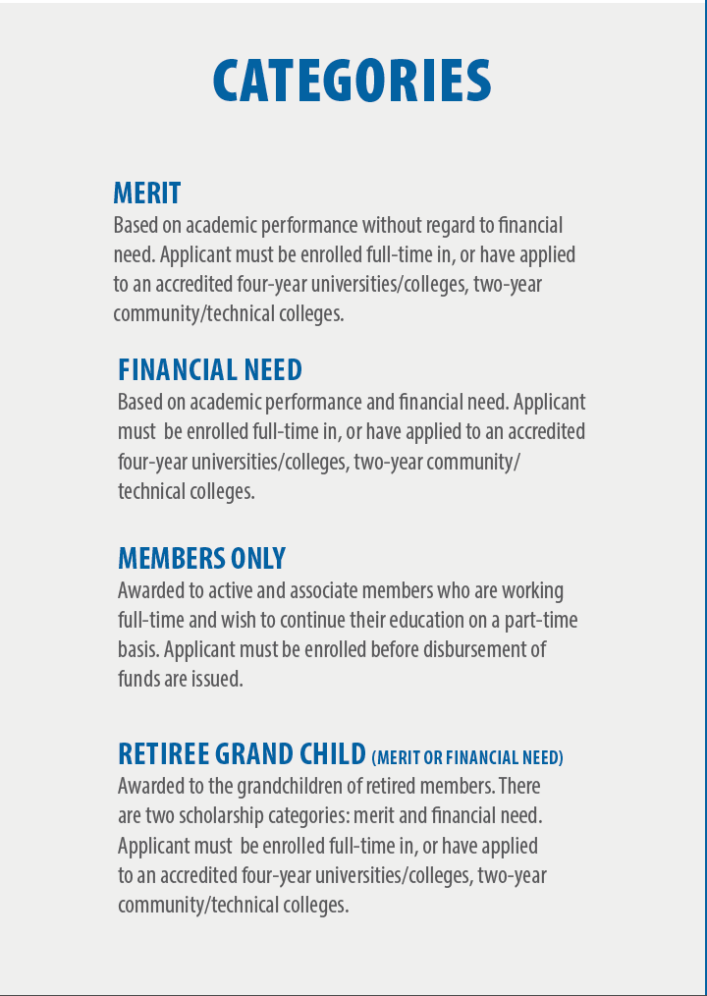
Scholarship Categories

Slide 12

Leadership NC Scholarship
SEANC’s Emerging Leaders Council has established a scholarship program to allow one SEANC member the opportunity to participate in Leadership North Carolina (LNC), a two-year training program where participants acquire the skills necessary to take the lead. Apply by April 30.

Slide 13
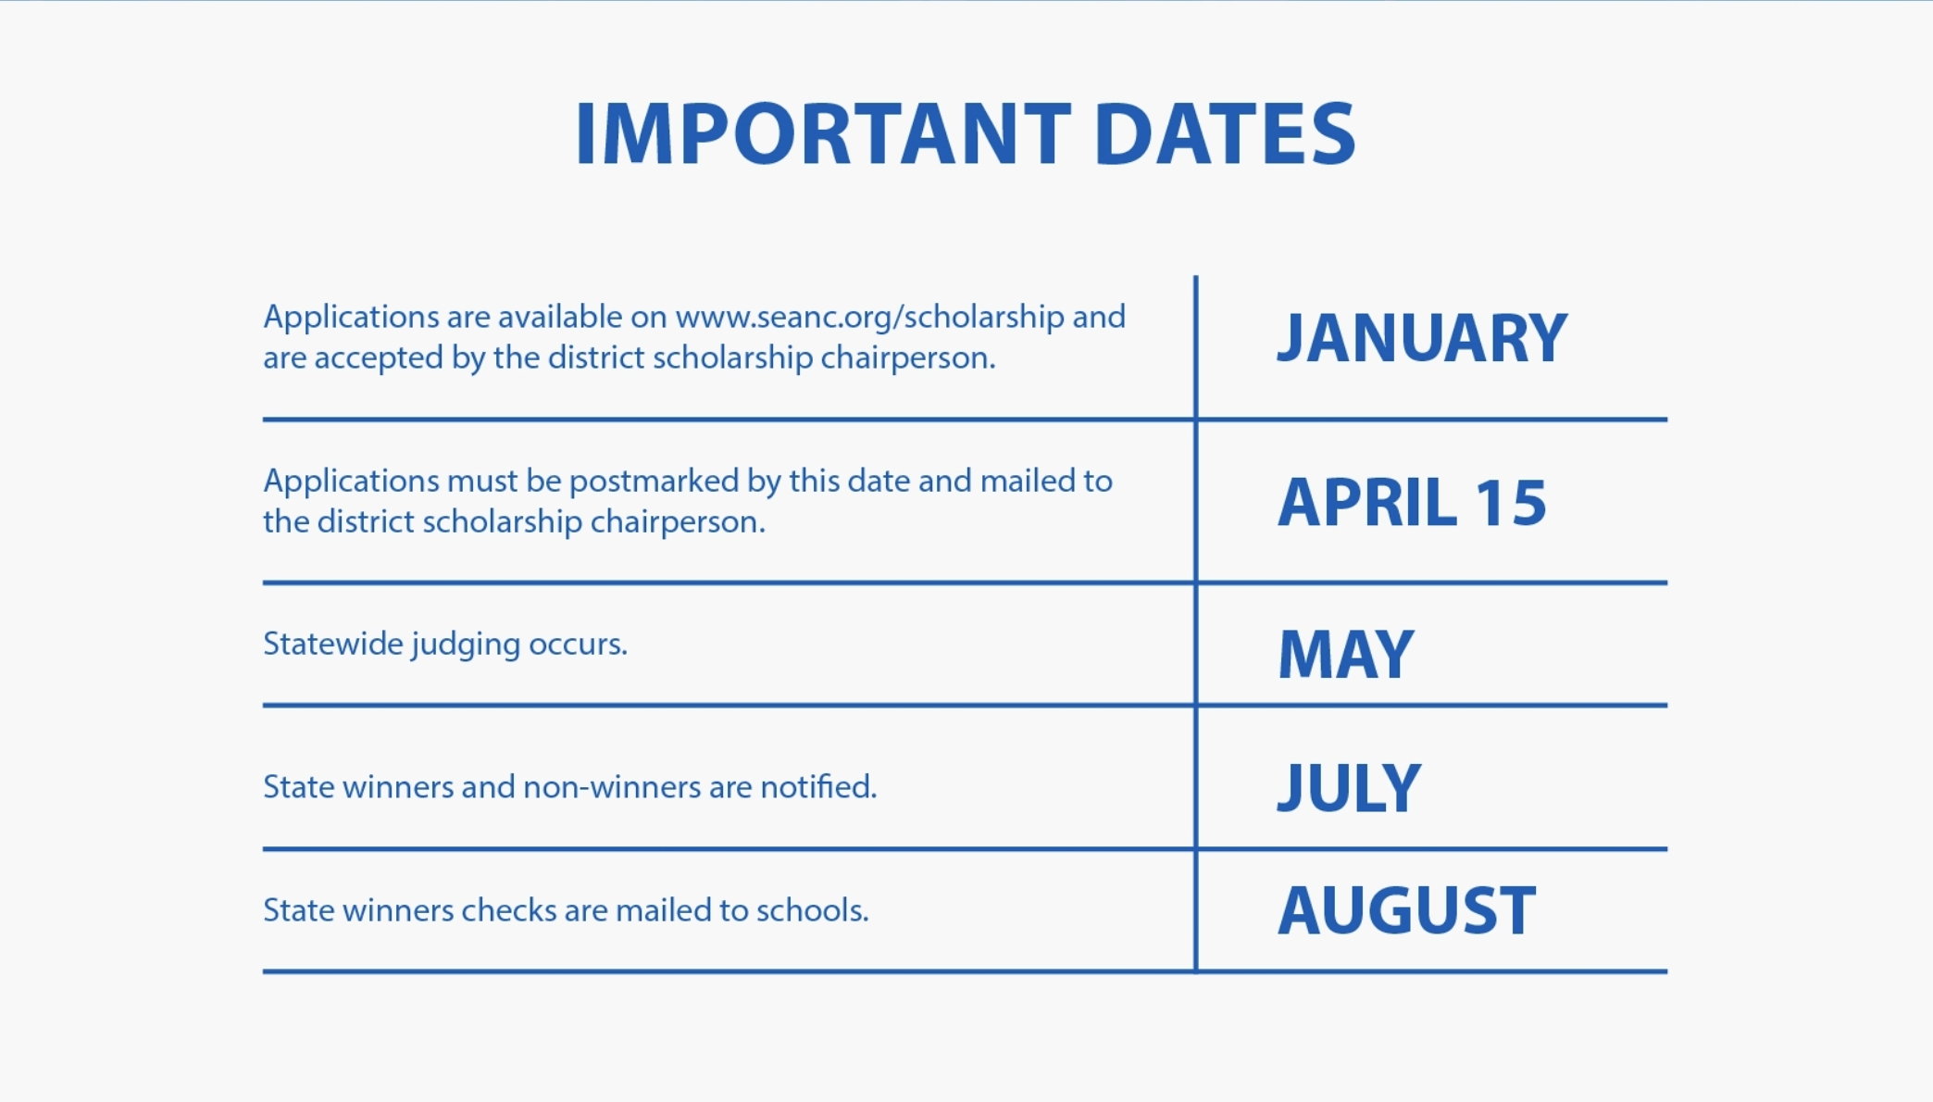

Slide 14


PUBLICATIONS AND ALERTS
Weekly E-Newsletter
Text Alerts

Slide 15

State Employees organized to Raise Money for candidates who support quality public services.
91% of EMPAC-endorsed legislative candidates were elected in 2016, including Governor Roy Cooper and Treasurer Dale Folwell.

Slide 16
APPLICATION

Slide 17
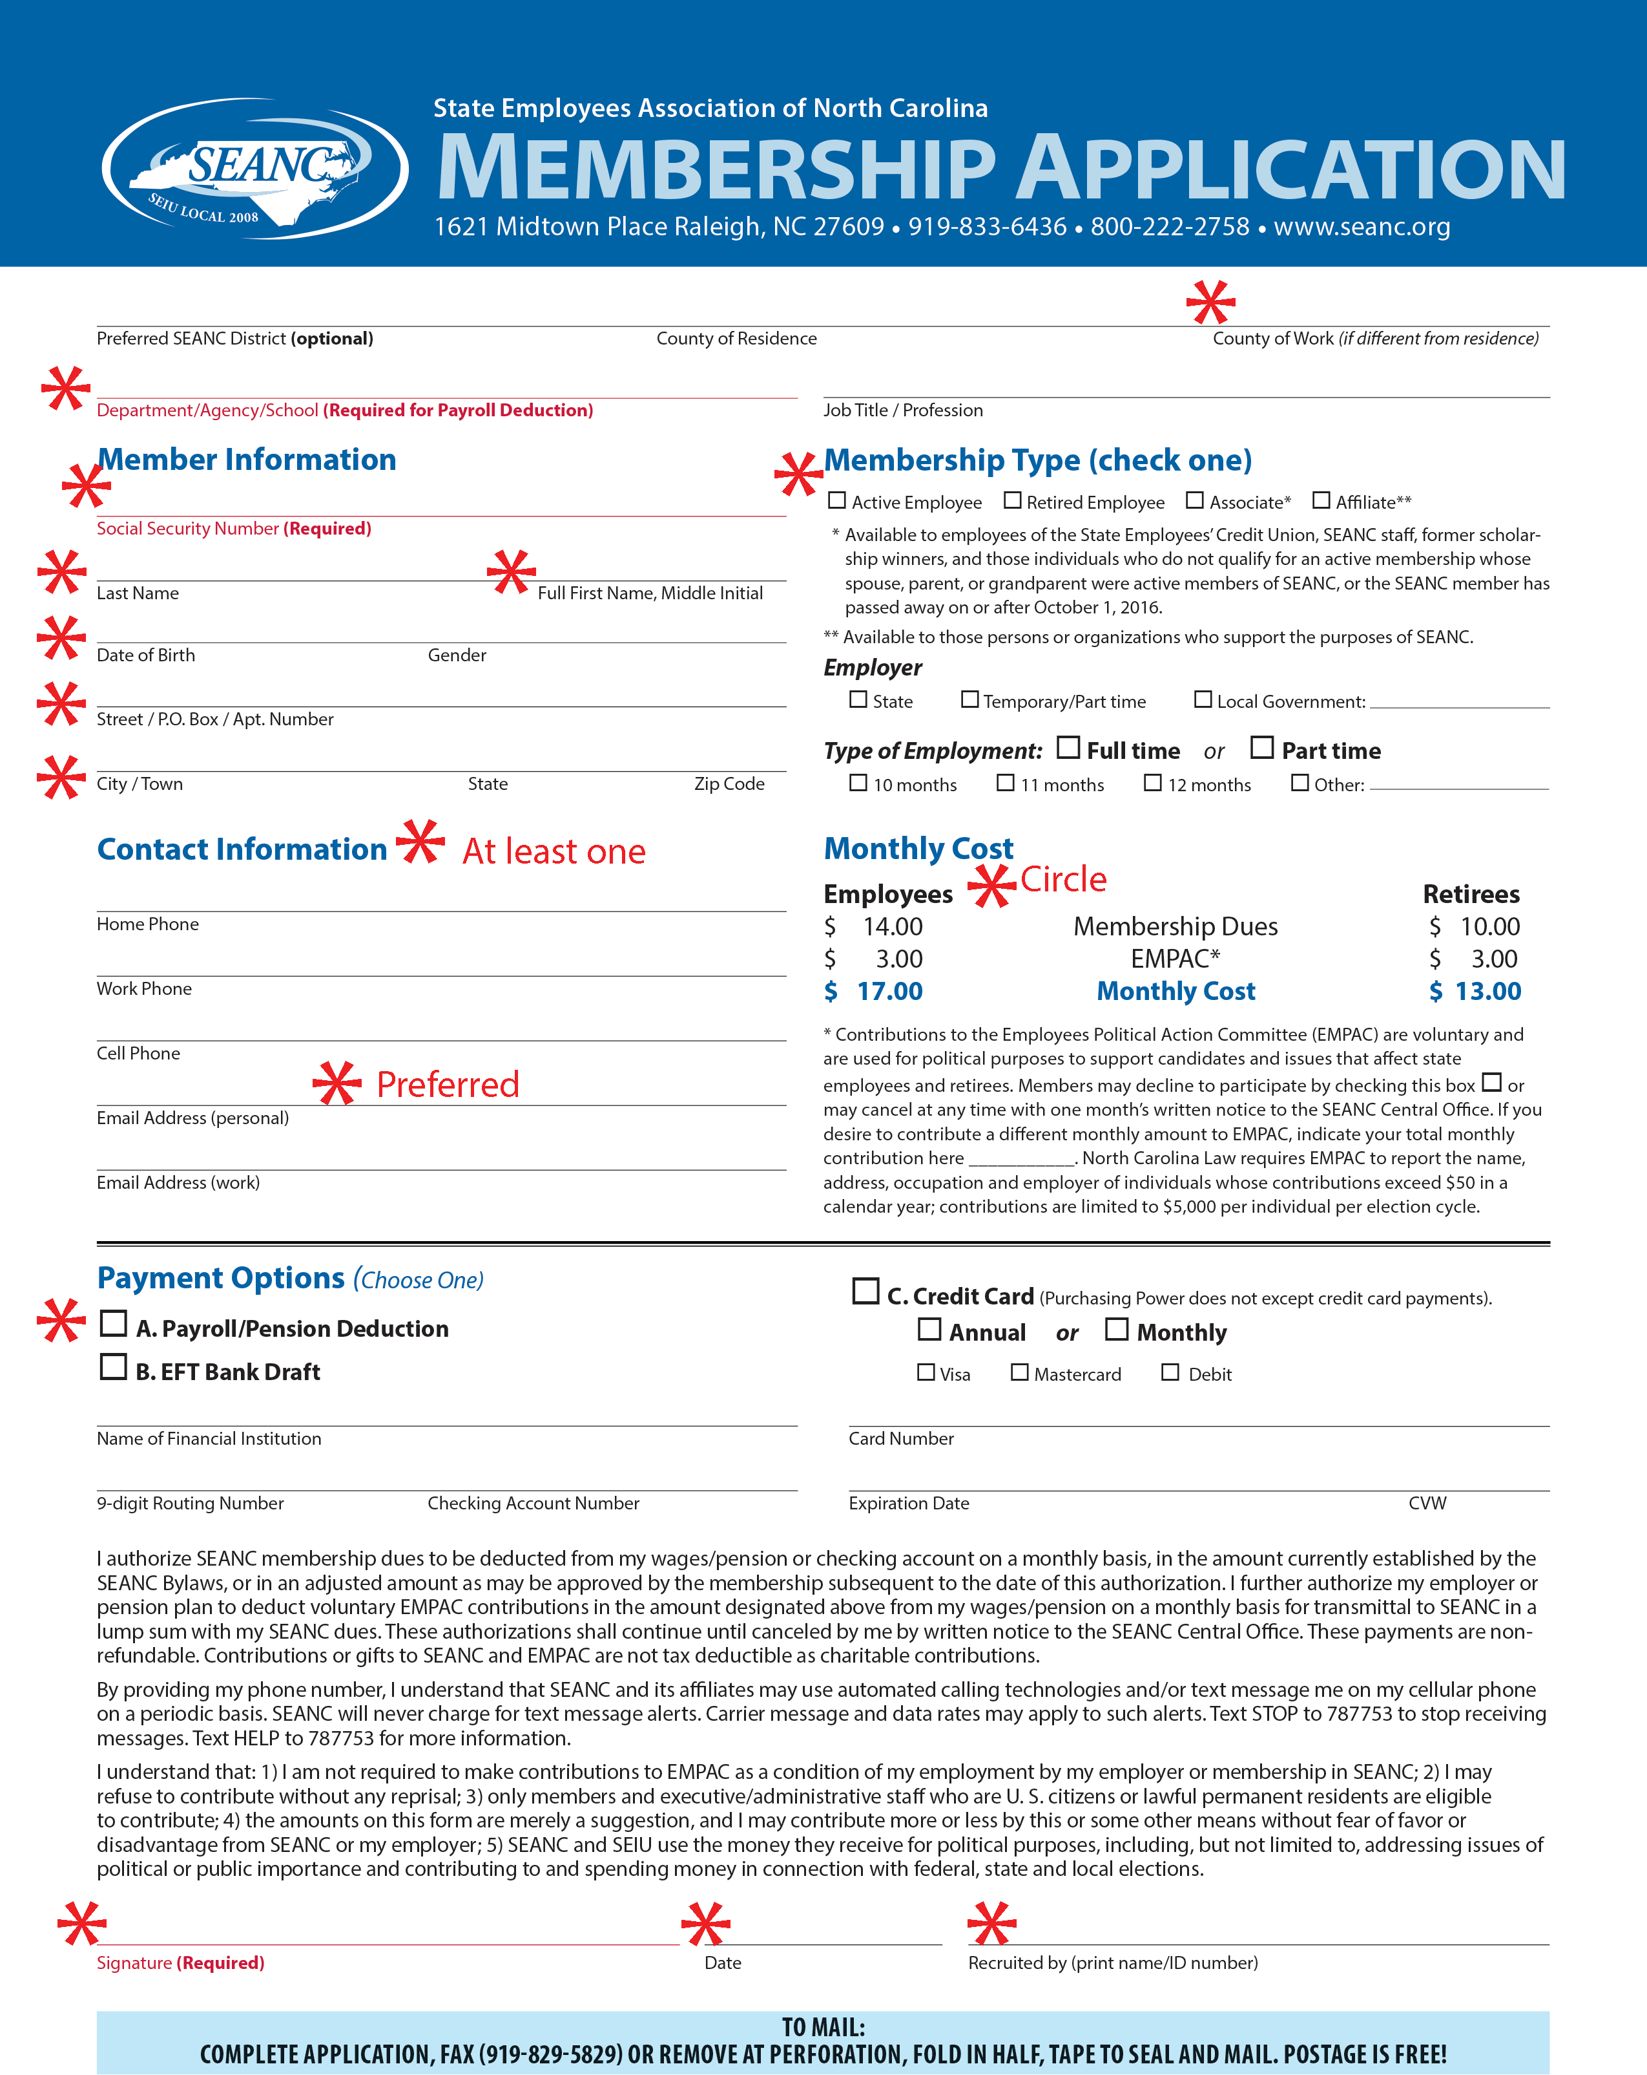
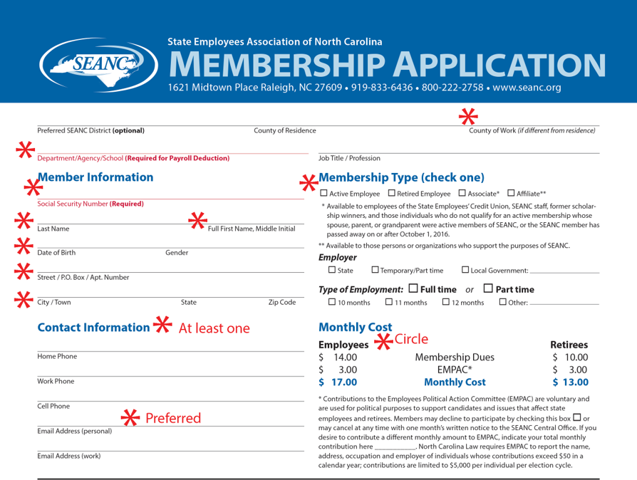

Slide 19
For more information about SEANC and its benefits, visit: seanc.org/memberguide

